Slide 1
Luganda voice-controlled wheelchair
Okiror Samuel Vinald
Ankunda A Adi

Slide 2
Aim and objectives
The main objective is to develop a Luganda voice-controlled wheelchair system
Specific objectives
To collect and curate a Luganda voice dataset for common wheelchair movement commands.
To develop, train and evaluate a speech intent recognition model to classify spoken Luganda commands.
To integrate the trained model with a wheelchair to form a voice-controlled wheelchair system.
To evaluate the system.

Slide 3
Luganda Model
Data is split into training and test datasets
Features being extracted are Spectrograms.
Trained two models as described below
Converted the TF Model into Tflite Model for Deployment on Hardware.

Slide 4
Hardware
Prototyping the model
Code for the deployment of the TFLite model

Slide 5
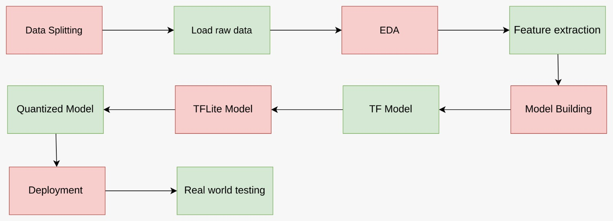
Methodology

Slide 6
Audio Properties

Slide 7
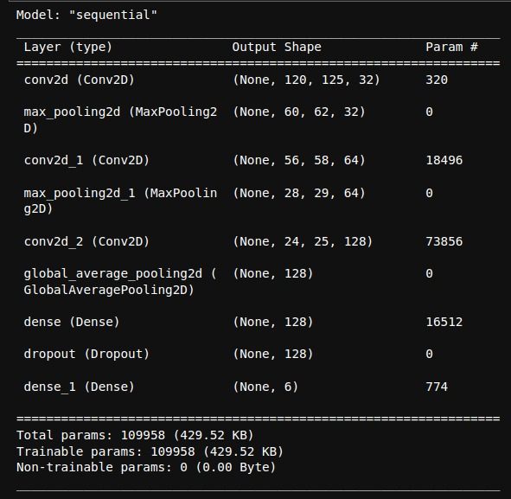
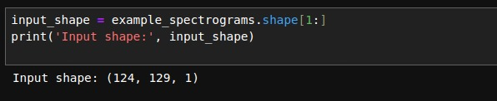
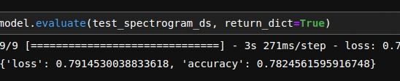

TF - Model - 1

Slide 8
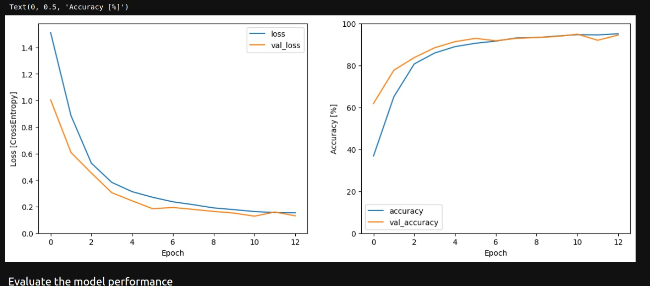
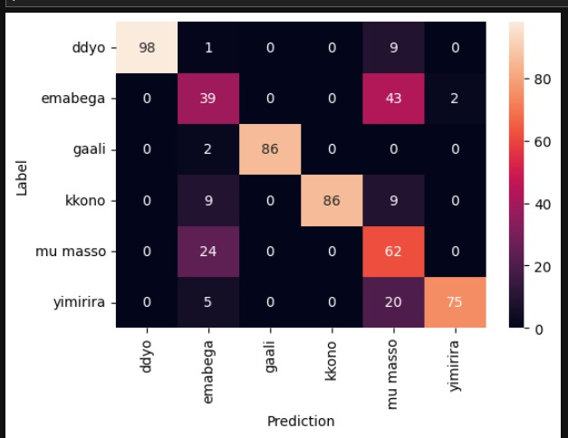
TF - Model - 1

Slide 9




TFLite - Model - 1

Slide 10
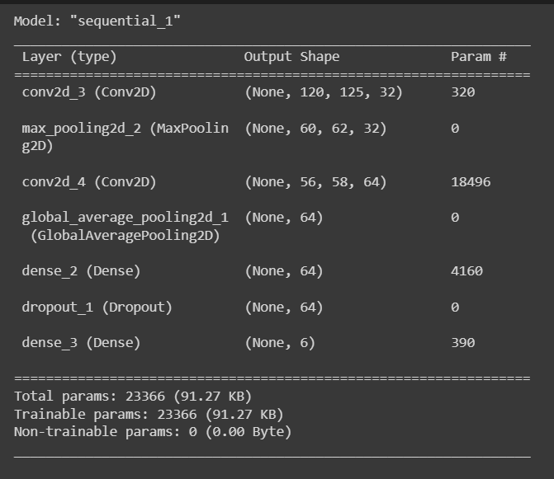


TF Model - 2

Slide 11
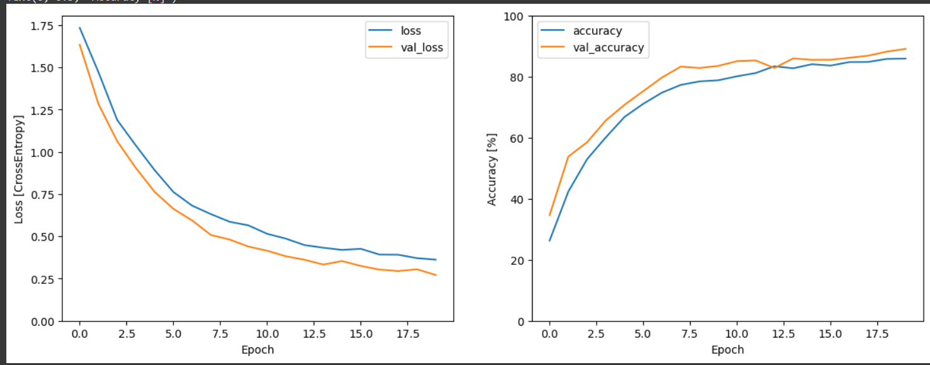
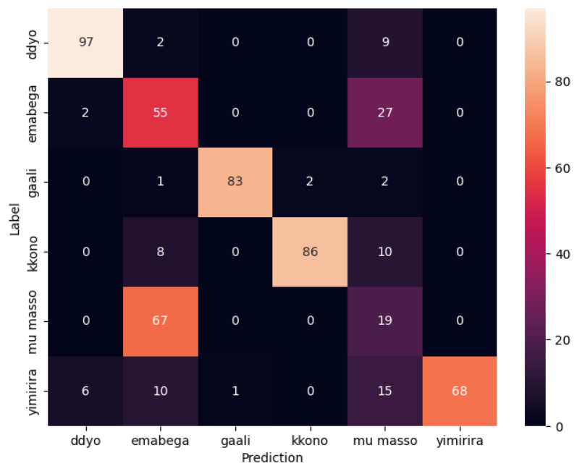
TF Model - 2

Slide 12


TF Model - 2

Slide 13
Current status
Working on the hardware prototype
Training of the Luganda models
Full final year project report
Working on objective two and three

